Slide 1
College Football Bowl Game Analysis
Initial Analysis, Research Questions, and Road Map

Slide 2
Project Overview
Focus: Analyze college football bowl games
Dataset: Combined results including attendance and outcomes
Main variables:
Attendance over time
Day of week played
Bowl game results

Slide 3
Research Questions
Do teams with higher average attendance tend to win their bowl games?
Summary statistics, diff between winner and loser capacities
Pie chart for big10 teams
Should I do one for each conference
Should I run a linear regression on what conference they are in and if they won?
Box plot on attendance for 2023 and 2024
Do certain days of the week correlate with better team performance or more competitive games?
Bar chart for distribution of games played on which days
ANOVA test
Does winning a bowl game lead to changes in attendance the following year?
Histogram shows distribution of attendance change for winners and losers
Log regression
T-test

Slide 4
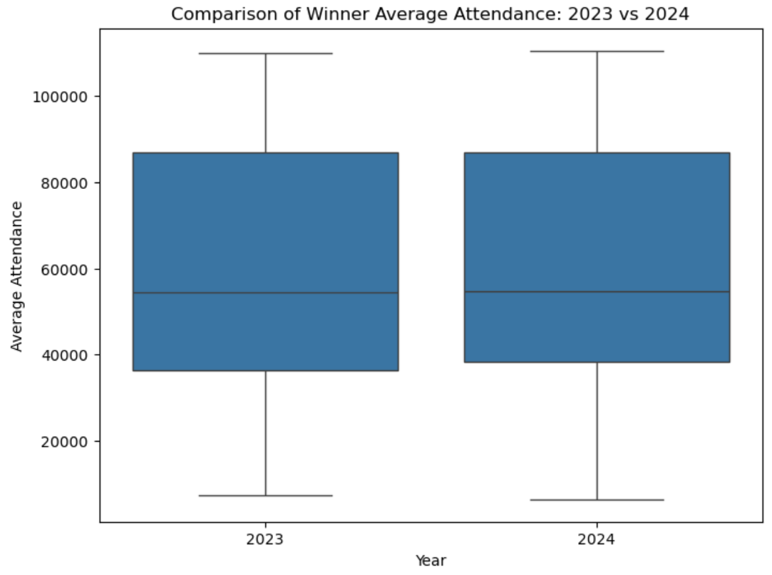
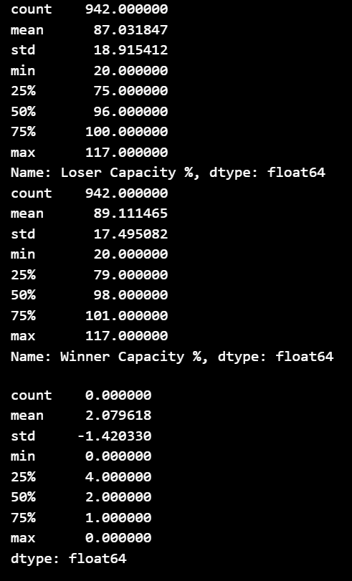
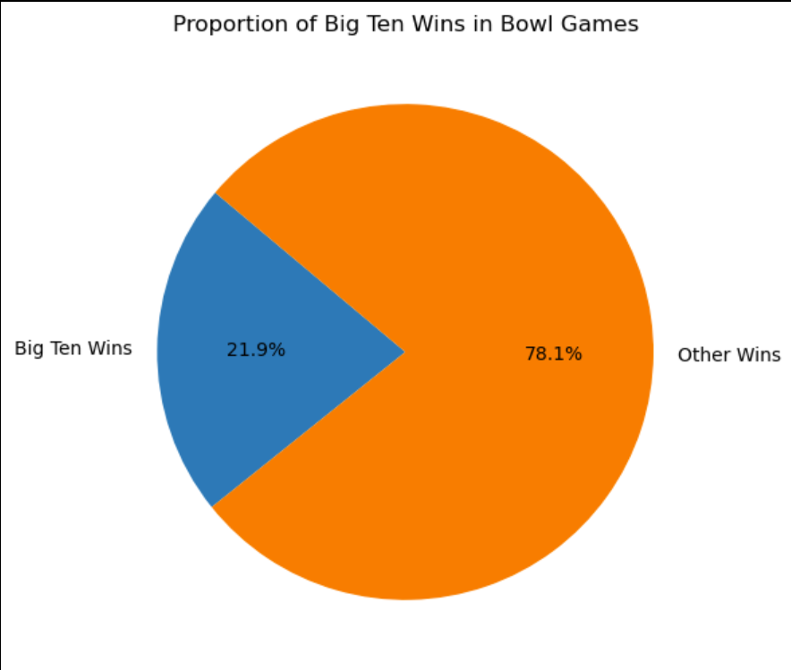
Attendance vs Winning
Should the focus be on big10 or all teams?
Summary stats show comparison of average attendance over 5 years for winners vs. losers
Can see a slight increase in 2024 attendance for winners
Is this difference valid or do in need to narrow down the teams
Comparison plot, winners and attendance
Correlation matrix plot

Slide 5
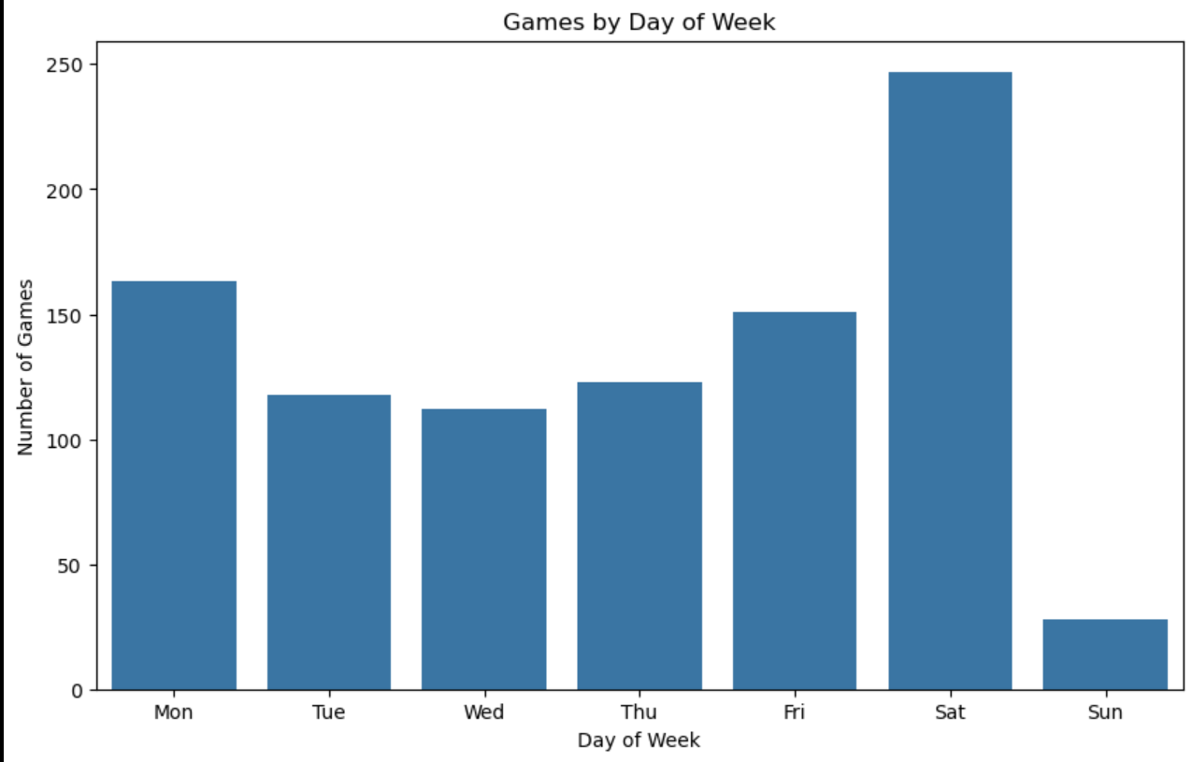
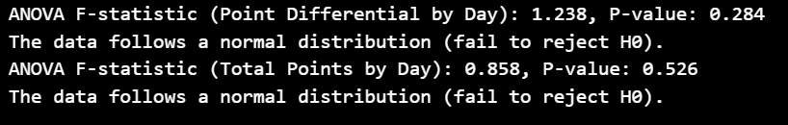
Game Day Performance
Bar chart show distribution of when games are played
Anova test, comparing means of each day of the week

Slide 6
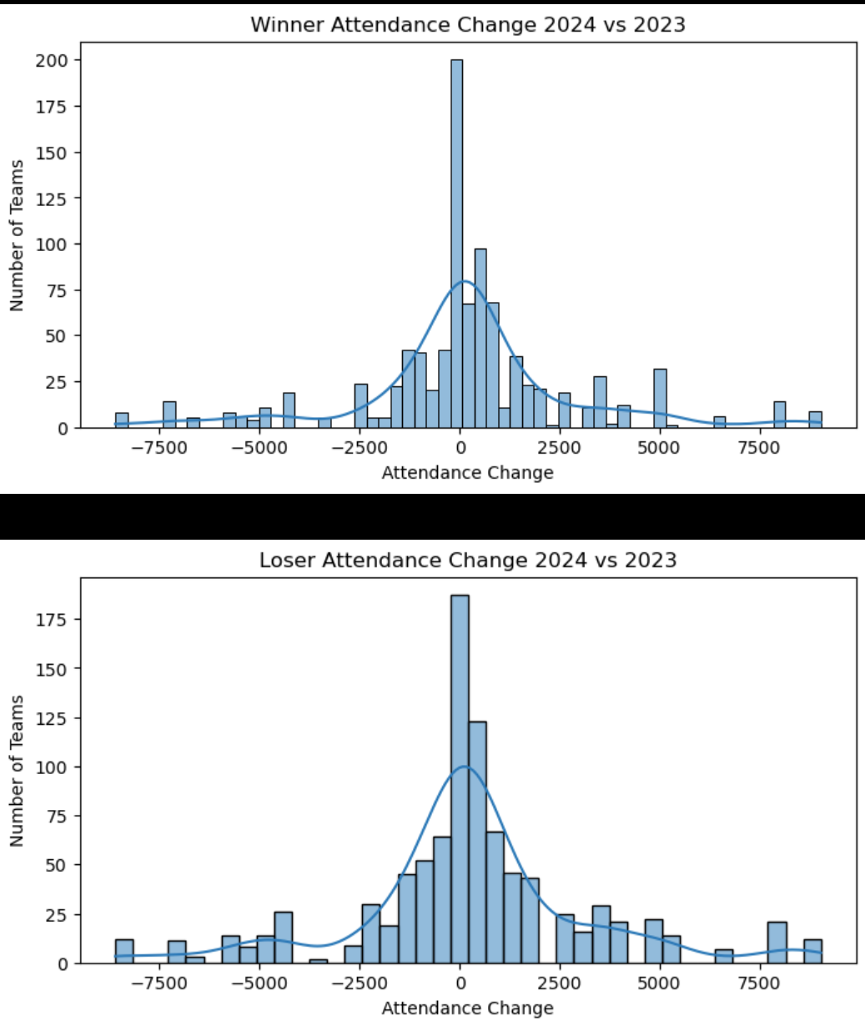

Attendance change
Bar charts showing the attendance change for winners and losers
T-test comparing the means of each group
Should it be a z-test instead?
Logistic regression predict if there will be attendance growth based on average attendance and points scored for the winners
Am I not allowed to use average attendance, is that data leakage?

Slide 7
Do certain days of the week correlate with better team performance or more competitive games?
There is no significant difference in outcome of the game to the day of the week the game was played on
Does winning a bowl game lead to changes in attendance the following year?
There is a slight change. Winning teams have a bit of an increase in attendance from 2023 to 2024

Slide 8
Road Map
Analyze data given from t-tests and log regression
Lay out initial hypotheses test and show compare if the data should reject or accept null hypothesis
Try additional Machine Learning models (Decision Tree, linear regression)
Update and finalize data dictionary
Should the box plot for question 1 be used for question 3?
Use answers to questions integrated in slides to polish tests and ensure correct methods

